Slide 1
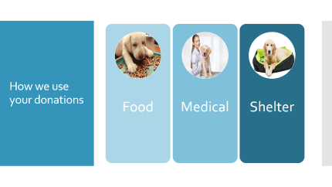
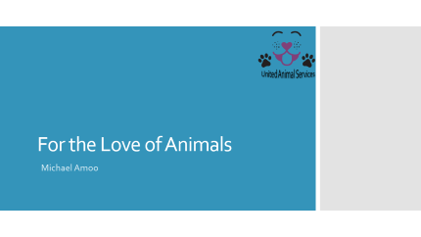
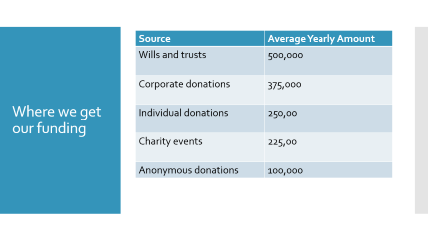
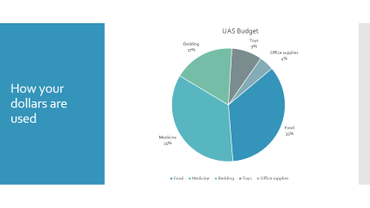
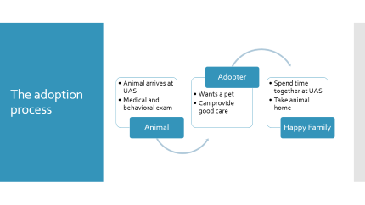
United Animal Services (UAS)

Slide 2
For the Love of Animals
United Animal Services
Michael Amoo

Slide 3
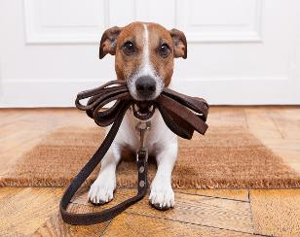
Meet our mascot, Daisy!

Slide 4
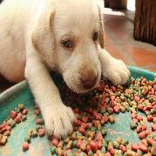
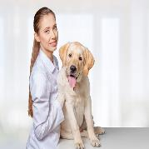
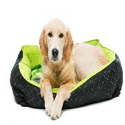
How we use your donations
Food
Medical
Shelter

Slide 5
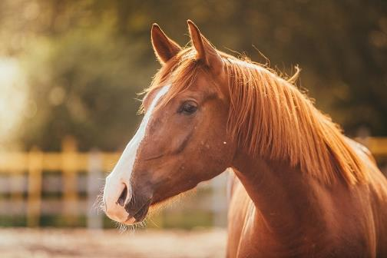
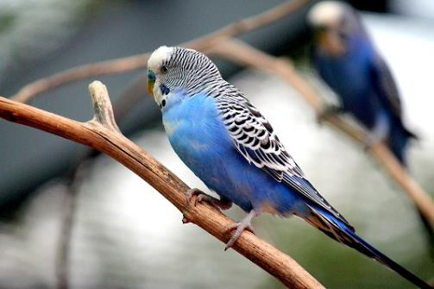
Big Red
Baby Blue

Slide 6
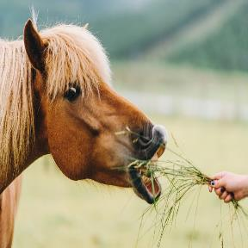
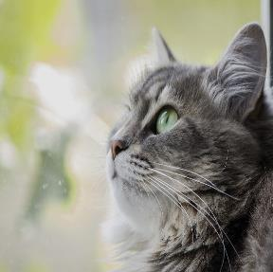

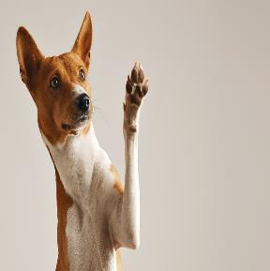

Every pet deserves a home
Every pet deserves a loving home

Slide 7

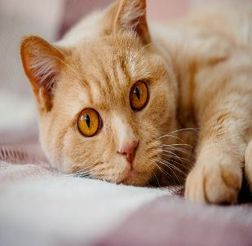
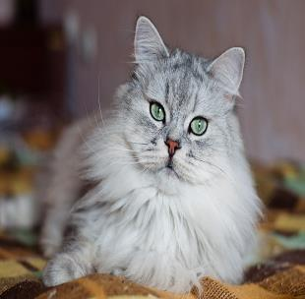
Purr-fect felines

Slide 8
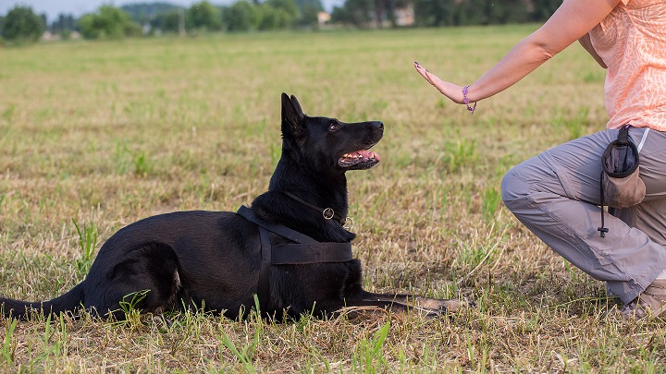
Training is an important part of what we do

Slide 9
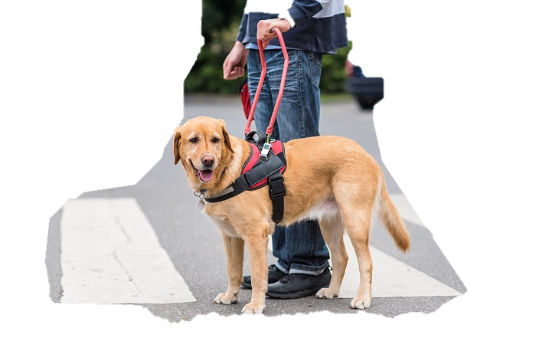
We train and provide service animals

Slide 10
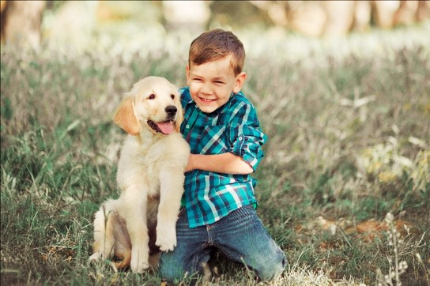
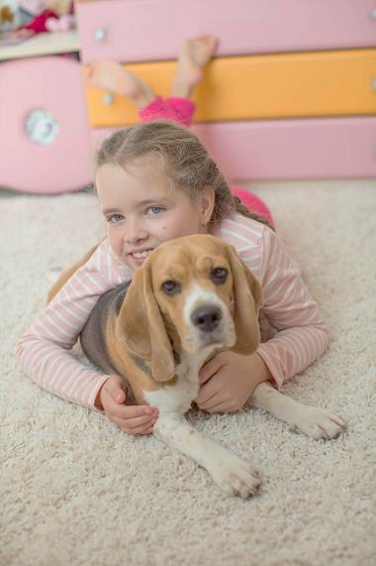
Kids love dogs

Slide 11
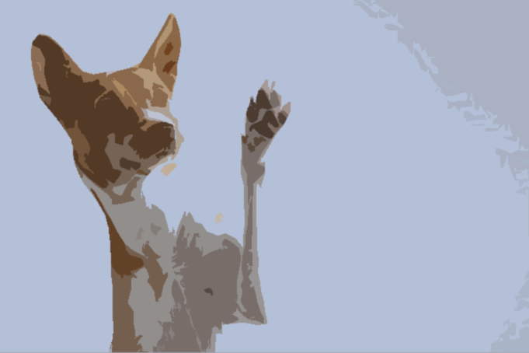
Am I your new best friend?

Slide 12
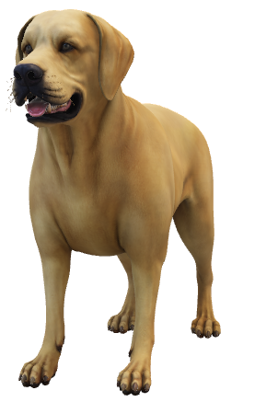
Thank you for saying yes!

Slide 13
The adoption process
Adopter
Animal arrives at UAS
Medical and behavioral exam
Wants a pet
Can provide good care
Spend time together at UAS
Take animal home
Animal
Happy Family

Slide 14
How your dollars are used

Slide 15
Where we get our funding
Source | Average Yearly Amount
Wills and trusts | 500,000
Corporate donations | 375,000
Individual donations | 250,00
Charity events | 225,00
Anonymous donations | 100,000

Slide 16
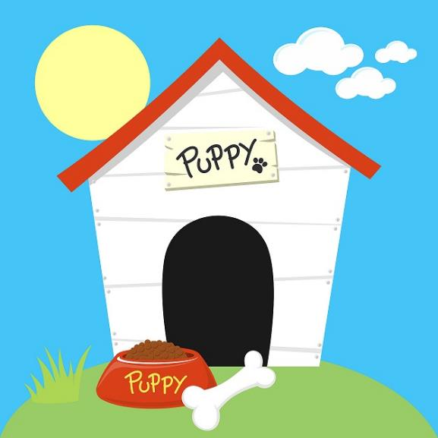
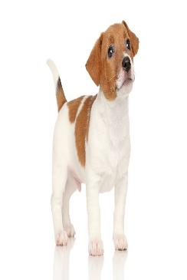
Why should you be lonely?

Slide 17
Somebody loves you!

